Slide 1

Fiber Map
Everett Neucere – Neucere1@tamu.edu
John Martinez – John.Martinez@tamu.edu
Franklin.martinez25@tamu.edu

Slide 2

Introduction
TAMU has a project surveying its entire Fiber optic network
Needs easy way to share the data
Web map is perfect for this use
Customer
Andrew Evans

Slide 3
Requirements
User Friendly
Secure
Easily Sharable
Easy to Update

Slide 4

Methodology
Used ArcGIS web app builder to create site
Added data to the Web Map
Symbolized data
Published Web Map
Customized Web App

Slide 5
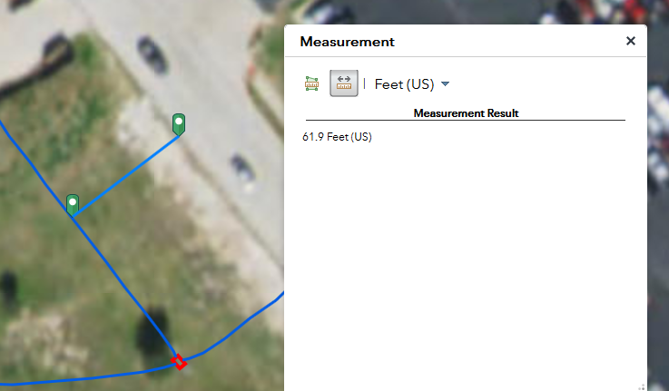
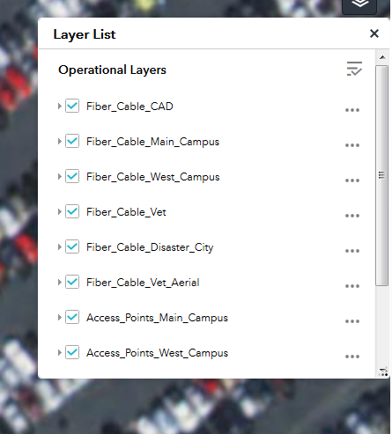
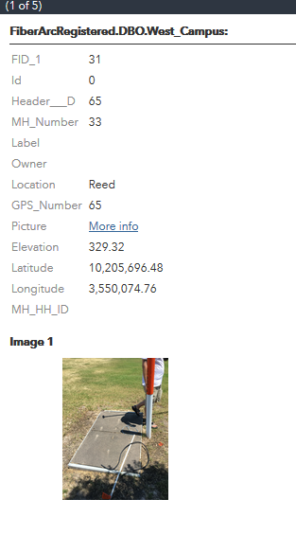
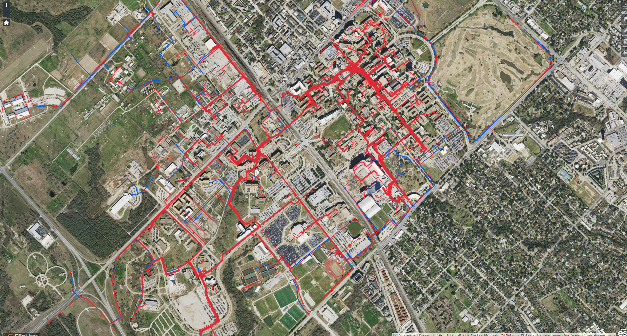
Demo
Link
Measurement tool
Layer Toggling
Sample Attribute Table
Overview of map

Slide 6

Questions?

